Slide 1
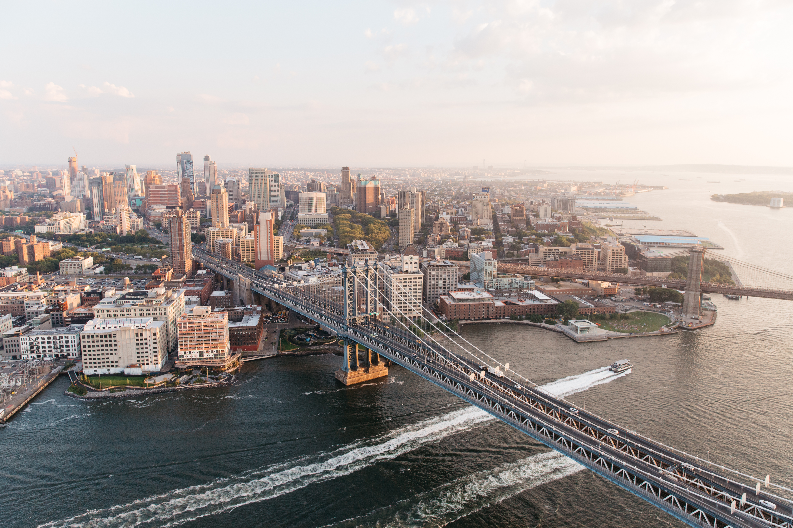
MAINSTREAM SOCIAL MEDIA MARKETING
STRATEGY AND IMPLEMENATION PLAN
{Jung education}
{Yangha Park}
{10/5/2018}

Slide 2
contents
Organisation overview and research
Mainstream social media marketing strategy
Implementation plan

Slide 3
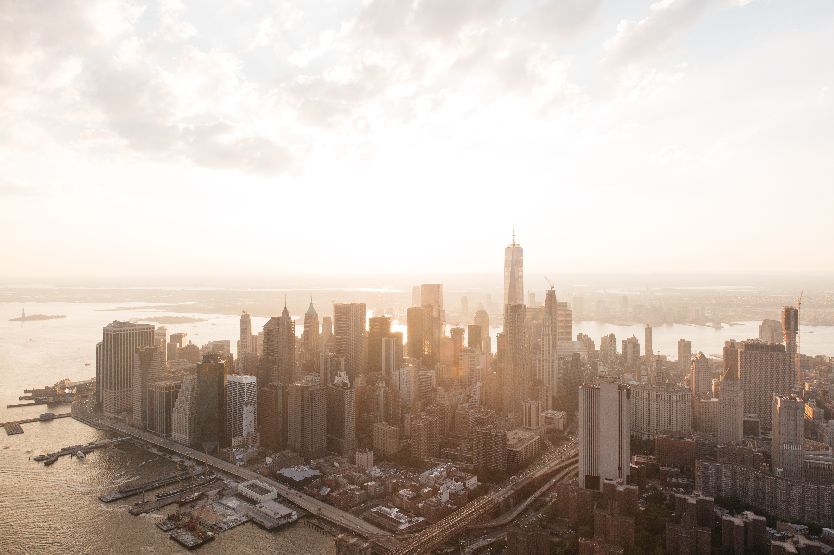
Stage 1.
Organisation OVERVIEW AND RESEARCH

Slide 4
ORGANISATION OVERVIEW
Provide an overview of the organisation you have selected for the purpose of this assessment and answer the key questions below in your description.
What is the name of the organisation? Jung Education
Please provide a brief history of the organisation. Established in 2006
What products and/or services does the organisation offer? Education
What is the pricing tier of the products and/or services offered? Various
What are the main sales channels? Naver Blog
Where is the organisation located? Sydney
What geographies does the organisation work in? Sydney
Who is the organisation’s target audience? 20-40 years old Korean living in Sydney with temporary visa and 18-40 years old Koreans who want to study in Australia.

Slide 5
GENERAL MAINSTREAM SOCIAL MEDIA NETWORK OVERVIEW
Channel | Key features | Marketing Opportunities | Primary audience | Paid vs free features
Facebook | Connect people | Target audience Advertise Increase brand awareness Mutual communication Analytics | Over 1.5 Billion people | Paid : Flexible cost, target audience and geography. Free : Viral content
Twitter | Community exchange information quickly Conversational | No cost advertise Easy communication | Over 500 million people | Paid : Not really effective. Promoted account, trends, and tweets. Free : Easy to tweet
LinkedIn | Business connection | Connecting to experts in the same industry. Recruiting. Question and Answer. Recommendations and Endorsements. | Over 400 million people | Paid : Targeted marketing, Conversation tracking. Free : Stay in touch with business partner.
Instagram | Simple image and video that are easy to make | Stand out from the crowd, Analyse insights, and Seek new customers. | Over 500 million people | Paid : Business profiles, Targeted promoted ads. Free : Simple visual ads that suited to brands in visual industry
Pinterest | Twitter and Facebook Mixed | Drive website traffic Brand awareness Engage with customers | Many people | Paid : Business account, Target audience, Reach a receptive audience. Free : Viral content
Google + | Optimised for businesses that use Google Adwords. | Search engine ranking | Numerous people | Paid : Google AdWord Free : Posts on google+ improve their search engine ranking
YouTube | Video based Search engine | Visual advertising | More than 1 Billion | Paid : Choose maximum cost per view. Target audience. Free : Video is more powerful than copywrite

Slide 6
MAINSTREAM SOCIAL MEDIA MARKETING PROFILE AUDIT
Channel | Profile/website URL | Profile Activity (1 = post < once per month 5 = post everyday) | Page relevant and is the profile up to date? (Yes/no) | Admin owner(s) | Type(s) of content posted | Audience engagement level (volume of likes/shares/tweets, etc.)
Blog / Website | https://blog.naver.com/happy_guys | 1 | No | Yes | Posts related to schools in Australia | 0
Facebook | https://www.facebook.com/jungeducation/ | 1 | no | Yes | Events, updates | 0
Twitter
Instagram
Pinterest
Google +
LinkedIn
YouTube

Slide 7
MAINSTREAM SOCIAL MEDIA MARKETING STRATEGY AND CAMPAIGN AUDIT
Type | Currently active? | Activity type | Frequency | Social Media Network | Sponsored / Promoted | Owner / Resource
Owned Content | No | Event | Once per month | Facebook | No | N/A
 |  |  |  | Naver blog | No
3rd Party Content | Yes | Promotion of colleges in Australia | Once per month | Naver blog | No | N/A
Paid Ads | N
Promotional Posts | N
Community Management | N

Slide 8
MAINSTREAM SOCIAL MEDIA NETWORK
Content CONSTRAINTs
Category | Constraint/Requirement
When not to post | When there is negative publicity about the organization and/or industry, when there is some serious issues about Australia.
What not to post | Racism, inappropriate language, something disrespectful to stakeholders, and/or competitors.
Where not to post | Korea Government website, Competitors’ blogs or websites or social media channels or groups. Blogs, groups, social media channels where our audience is not there.
Who not to target | Elder people, People that don’t speak Korean, People that are not interested in moving to Australia.

Slide 9
MAINSTREAM SOCIAL MEDIA NETWORK
GLOBAL TRENDS AND OPPORTUNITIES
Case Study | Organisation 1< Go Study > | Organisation 2< Information Planet Australia > | Organisation 3
Social Media Network | Facebook, Twitter, YouTube, Instagram. | Facebook, Twitter, google+, Linkedin
Geography | Sydney, Australia. | Sydney, Australia
Marketing Objective | Increasing the number of customers and brand awareness. | Increasing the number of customers and brand awareness.
Marketing Solution | Very active on social media. They created a lot of video content. They use testimonials. | They provide professional information for study in Australia.
Primary Benefit(s) | They helped 10,000 people in 5 years. | They helped 30,000 students in 20 years, and have 49 branches all around world.
Secondary Benefit(s) | Increasing fans on Instagram and engagement on this social media channel. | They got more than 10,000 followers

Slide 10
Stage 2.
MAINSTREAM SOCIAL MARKETING STRATEGY

Slide 11
MAINSTREAM SOCIAL MEDIA
TARGET AUDIENCE SEGMENTS
1. Above 18 years old Koreans in Australia who hold a temporary visa or who want to study.
2. 14 to 30 years old Korean in Korea who want to study abroad, especially in Australia.
3. Koreans who want to immigrate to Australia.

Slide 12
MAINSTREAM SOCIAL MEDIA
TARGET AUDIENCE CANVAS #1
Target audience name: _Gildong, Hong____________________________________________________
Target audience demographic and characteristics Gildong is 25 years old Korean man who want to study cookery. He has learnt cooking for 3 years but he isn’t good at speaking in English. He is positive, active, and easy-going. | Goals To be a chef in Australia and get a permanent visa. | Buying process Gildong applied for an online consultation after seeing a post about ‘how to be a chef in Australia’ Online Consultation Personal Consultation Quoting. Decision making. |  |  | Influencers/stakeholders/buyer teams Alumni of cookery course who gave testimonial for the post, Marketing team, the Consultant.
 |  | Timing High peak intake season 2 weeks to 6 month |  | Sales channels Online | Social media networks Facebook
Questions they ask the organization How long does it take to be a chef in Australia in general? How much is the minimum salary for year as a chef in Australia? What should I do to prepare to get a permanent visa? How long time it take to get overall 6.0 IELTS score? Which one is the best cost-effective cookery college? Do I really need to go to the Le Cordon Blu for my future as a chef? |  |  | Content/information that engages them ‘Leisurely life in Australia’ post on the facebook. ‘The difference between child in Australia and in Korea’ post on the facebook. Information about the average salary of chef in Australia.

Slide 13
MAINSTREAM SOCIAL MEDIA
TARGET AUDIENCE CANVAS #2
Target audience name: _Chulsoo, Ahn____________________________________________
Target audience demographic and characteristics Chulsoo is a 19 years old boy who’ve just failed to enroll the university that he wanted to go. He doesn’t seem like a out-going, sociable. He wants to have information of Australia Universities. | Goals Getting overall 5.0 IELTS score, Acquiring diploma certificate, Looking for a good university that has the law course that he can go, and to start to study in a university. | Buying process Chulsoo contacted to a social media marketing staff via facebook messenger. The staff suggested alternative way to study law. Chulsoo’s parents called to our agency. They visited the office a couple of times to have a consultation. Quoting. Decision making. |  |  | Influencers/stakeholders/buyer teams Interviewee of the youtube video who have same experience as him, Marketing team, His parents, social media marketing staff, the consultant.
 |  | Timing The season of Korea’s university entrance exam for 12 years students. 1 to 6 month. |  | Sales channels Mixed | Social media networks Facebook youTube
Questions they ask the organization How much is the average annual tuition fee of Australia Universities? How much is enough for a living cost of international student? How much does it cost for home-stay? Isn’t it dangerous as an Asian in Australia in the view of racism? Roughly, how long time will Chulsoo need to be good enough in English to attend English-based lectures? |  |  | Content/information that engages them Videos of activities done by international students in Australia on youTube. An video of the interview of people who had had same experience as him and studied in Australia instead. Education seminar by Australia immigration.

Slide 14
MAINSTREAM SOCIAL MEDIA
STRATEGIC IDEAS
Primary Objective | Category | Content Ideas | Second Marketing Benefits
Increase the followers on Facebook | Case study | Make ‘Campus life of Sydney’ Video. | The number of online consultation is increased. The video has been shared 58 times.
Increase brand awareness | How to guides | Post ‘How to fight for the right as a tenant and a customer in Australia.’ | The number of followers is increased. It got lots of comments on the post.
Increase brand awareness | How to guides | Post ‘How to save money for living in Australia’ | The number of followers is increased. It got lots of comments on the post and people shared their idea by comments. The post has been shared 106 times.
Increase brand awareness | Important information | Post ‘What Australia law differs from Korean Law?’ | The post has been shared 77 times and it’s introduced on Korean popular Facebook group.
Increase brand awareness | Proactive community management | Start a Facebook group to help people suffering by unexpected accident in Australia. | The group has been introduced in different groups or websites many times. Korean-times made a news for this group.

Slide 15
MAINSTREAM SOCIAL MEDIA
STRATEGY
Strategic Initiatives | Campaign/always on | Content Idea | Social media network(s) | Frequency (must run over at least 3 weeks) | Key Performance Indicators (KPIs) | KPI Targets (per month)
1 | Always-on | Make posts to introduce ‘Good, Respectful Workplace’ for people in Sydney | Facebook Blog | Once a month | The number of shares. | 100 shares for a post.
2 | Always-on | Make posts for introducing some good deals(especially seasonal items) | Facebook Instagram youTube | 1-5 times by every quarter. | The number of shares. The number of comments. The increased number of followers or something like that. | 100 shares for every content. 100 comments for every content. Get 100 more follower or something like that whenever making a content.
3 | Campaign | Refer a friend to receive $200 voucher for you and your friend | Facebook Twitter Instagram | A month | Post clicks The number of shares | 200 clicks 30 shares

Slide 16




MAINSTREAM SOCIAL MEDIA
STRATEGY SUMMARY
Category | Facebook | Twitter | LinkedIn | Instagram | Pinterest | Google+ | YouTube
Owned media
Promotional
Third party media
Paid Media
Community Management

Slide 17
MAINSTREAM SOCIAL MEDIA
BUDGET OVERVIEW
Campaign | Expense Category | Expense Item | Forecasted Monthly Budget | Reporting Frequency | Budget Approval
Overall | Strategy/Management | Strategy consultation/Social media management platform community manager | $500/$500 | Monthly/Monthly | Agency Boss
Campaign 1 | Content Creation | Interviewer Copywriter | $200 $150 | Monthly | Marketing Director
Campaign 2 | Content Creation | Copywriter | $100 | Every quarter | Marketing Director
Campaign 3 | Content Creation | Copywriter Graphic Designer | $200 $300 | Per Campaign | Marketing Director
Totals___

Slide 18
Stage 3.
MAINSTREAM SOCIAL MARKETING IMPLEMENTATION PLAN

Slide 19
MAINSTREAM SOCIAL MEDIA
IMPLEMENTATION PLAN
Campaign | Actions required | Task owner | Start date | End date
#1 | Collect information from working holiday workers or other people in Sydney and organize interview. Look for a copywriter. | Kim(Marketing staff) | 20/5/2018 | N/A
#2 | Search good deal items in the Aussie market, especially items that are needed in specific season and compare the price between them. | Park(Marketing staff) | 20/5/2018 | N/A
#3 | Look for a graphic designer to make an image for Instagram and facebook, Look for a partnership for vouchers. | Choi(Marketing Director) | 20/5/2018 | 31/12/2018

Slide 20
MAINSTREAM SOCIAL MEDIA
AUDIENCE FEEDBACK PROCEDURE
Type of comment | Enquiry | Positive comment | Neutral | Negative comment
 |  |  |  | Genuine feedback | Negative comments | Offensive/spam | Serious issue
Description | General questions about services | Positive comments about the agency | Neutral comments about the agency | Actual and valid feedback from a client or customer | A comment from an angry customer who is trying to battle the profile | Use of foul and malicious language, inappropriate ‘spam’ comment | Involves legal actions, threats, breach of confidentially, blackmail, etc.
Example | Can you quote for Certificate III cookery course in Le Cordon Blu? | Thank you for this post. I solved my problem seeing this! | Good day to die | I think some your opinions in your post can cause a quarrel | Your company charge higher cost than all others! | Lonely? Come here to make you warm->>> http://goo.gl/tinder333 | I hurt my eyes as seeing your profile picture! My lawyer will contact you soon.
Recommended response and action | Provide clear and concise answer | Express gratitude for the positive comment | Leave funny reply | Take a screenshot | Take a screenshot | Remove the comment | Take a screenshot
 | Try to make a customer to come to the office. | Share positive feedback on social media networks |  | Offer apologies | Offer apologies | Leave funny reply below (e.g I’m coming…<3) | Escalate to senior management
 |  |  |  | Provide assurance that their feedback will be taken into consideration | Ask them back which exact point is the one that they feel bad |  | Refer to the management/legal department

Slide 21


MAINSTREAM SOCIAL MEDIA MANAGEMENT PLATFORM EVALUATION
Social Media Management Platform | Advantages | Disadvantages | Price | Selection (tick which will be utilised for this organisation)
Facebook | Large scope of audience Can post various types of contents Specific target market Can communicate with customers | Loss of control Cost of maintenance | There is not a fixed cost
Instagram | Build brand image that you want to achieve with photos Free Advertising Reaching target market | Difficulty to deliver the meaning that you meant to audience. Can’t reach audience who use windows OS phone. | There is not a fixed cost
youTube | Large audience The well designed video may cause positive effect on google search ranking Provide more information than a post and an image. | Competition Higher advertising cost than other platforms No guarantee of desired outcomes | pay per view with an average cost per view ranging from $10-$30 (per thousand) with the option to have your ad in four standard ad formats.

Slide 22
MAINSTREAM SOCIAL MEDIA
STRATEGY MANAGEMENT SCHEDULE
Campaign Name | Content Strategy | Date / Time | Social Media Networks | Imagery | Target Audience | Resources Required | Campaign Manager | KPI Targets
Good, Respectful workplace | Increase traffic Expose brand name | 20/5/2018 | Facebook | Imagery | 20-40 years old Koreans in Sydney | Cost for survey and interview, Copywriter, Photographer | Kim(Marketing staff) | Traffic increasing
 |  | 20/5/2018 | Naver Blog |  | 20-40 years old Koreans in Sydney | Cost for survey and interview, Copywriter, Photographer | Kim(Marketing staff) | Visits increasing
 |  | 20/5/2018 | youTube |  | 20-40 years old Koreans in Sydney | Cost for survey and interview, Copywriter, Photographer, Video Editor | Kim(Marketing staff) | Views increasing
Find ‘REAL’ Hot Deals | Increase traffic Expose brand name | 30/5/2018 | Facebook | Imagery | 20-60 years old Koreans in Sydney | The item which is proper for this campaign, Graphic designer | Park(Marketing staff) | Traffic increasing
 |  | 30/5/2018 | Naver Blog |  | 20-60 years old Koreans in Sydney | The item which is proper for this campaign, Graphic designer, Copywriter | Park(Marketing staff) | Traffic increasing
Refer a friend | Increase sales | 30/5/2018 | Facebook | Imagery | 20-40 years old Koreans in Sydney | The partnership voucher, Graphic designer, Copywriter | Choi(Marketing Director) | Increased sales
 |  | 30/5/2018 | Instagram |  | 20-40 years old Koreans in Sydney | The partnership voucher, Graphic designer | Choi(Marketing Director) | Increased sales

Slide 23
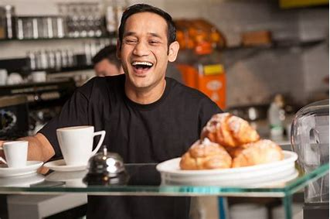
MAINSTREAM SOCIAL MEDIA
CAMPAIGN 1 CONTENT
Detail the content for the first campaign of the mainstream social media marketing strategy including the headline, any imagery and associated links that will be included where applicable.
Social media network | Content Type | Post Content | Associated Imagery | Associated Link / Tags (if applicable)
Facebook | Link | Have you ever heard Kanghodong 678? It’s one of the best workplace in Sydney! Read more http://blog.naver.com/jungedu
Blog | Post | 5 Reasons why Kanghodong is one of the best place to work in Sydney. The interviewee testimonials. Explain 5 reasons why.
Instagram | Image Link | Have you ever heard Kanghodong 678? It’s one of the best workplace in Sydney! Read more http://blog.naver.com/jungedu

Slide 24

MAINSTREAM SOCIAL MEDIA
CAMPAIGN 2 CONTENT
Detail the content for the second campaign of the mainstream social media marketing strategy including the headline, any imagery and associated links that will be included where applicable.
Social media network | Content Type | Post Content | Associated Imagery | Associated Link / Tags (if applicable)
Facebook | Post | The items that you must have in Summer in Sydney! Read more…
Instagram | Image | The items that you must have in Summer in Sydney! <Short version video(1min)>
youTube | Video | The items that you must have in Summer in Sydney! <Long version video(5min)> Compare 3 good surfing board to buy Compare 3 good swimwear shops in Sydney Compare 3 good travel package to sea

Slide 25

MAINSTREAM SOCIAL MEDIA
CAMPAIGN 3 CONTENT
Detail the content for the third campaign of the mainstream social media marketing strategy including the headline, any imagery and associated links that will be included where applicable.
Social media network | Content Type | Post Content | Associated Imagery | Associated Link / Tags (if applicable)
Facebook | Post | Give $200 voucher to your friend and yourself Are you or your friend planning to apply Student visa? Get qualified good service and $200 voucher as well! <image>
Twitter | Copywrite | Student Visa? Give $200 voucher to your friend and yourself → http://goo.gl/dk3Kdi
Instagram | Image | Give $200 voucher to your friend and yourself Are you or your friend planning to apply Student visa? Get qualified good service and $200 voucher as well! <image>

Slide 26
SMMMSM502A
Make
An
Impact

